Slide 1
Estonian Aviation Academy 2019 China - Estonia Cooperation Conference Capacity of the aviation training in Estonia
Jaanus Jakimenko, rector

Slide 2
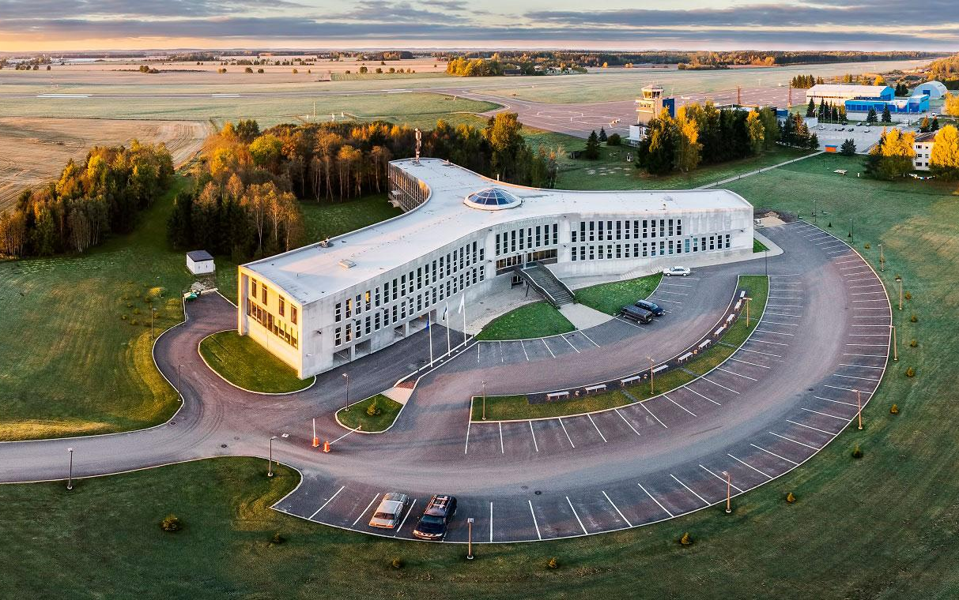
Facts and Figures
Students 250
Graduates 730
Employees 55
Foundation 1993
(Tartu Aviation College)
Main specialisation:
Air Traffic Services*
Aircraft Piloting* (Aeroplane & Helicopter)
Aircraft Engineering*
Communication and Navigation Systems
Aviation Management
* specialities certified by Civil Aviation Administration and audited by European Aviation Safety Agency

Slide 3
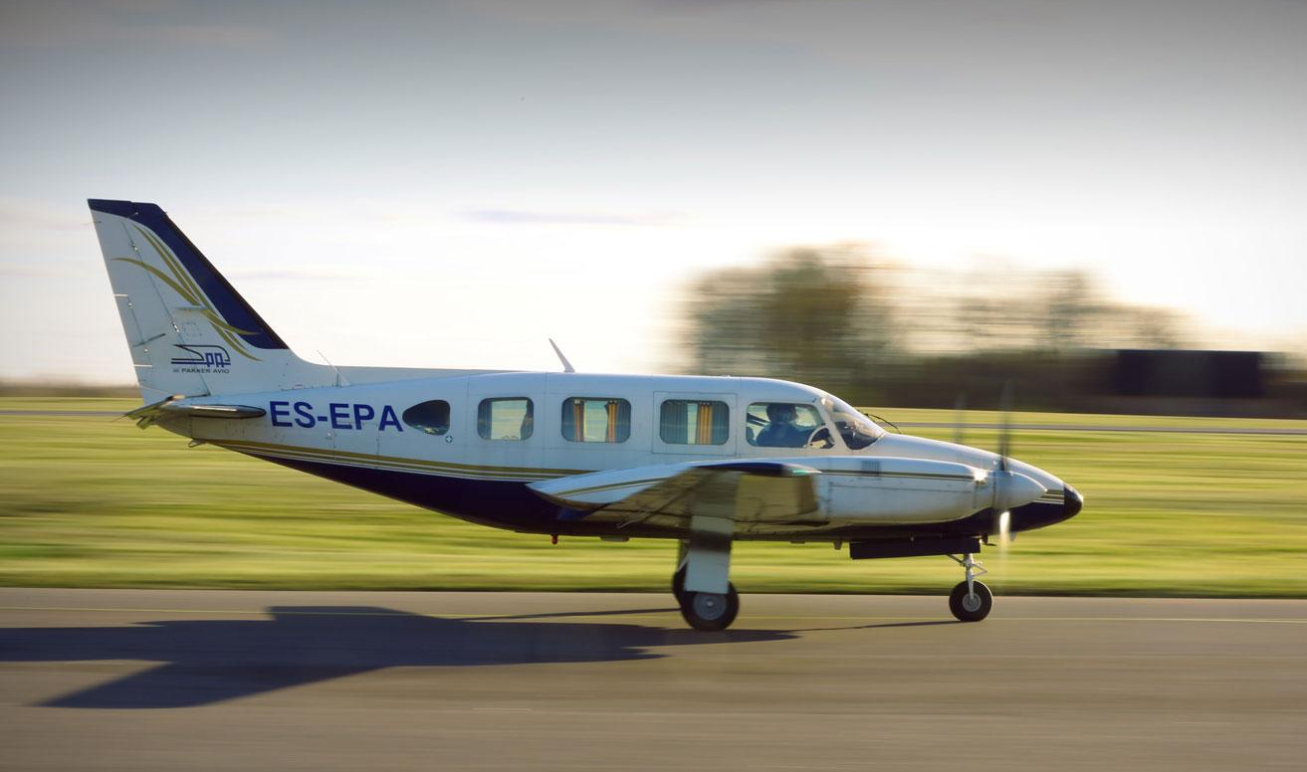
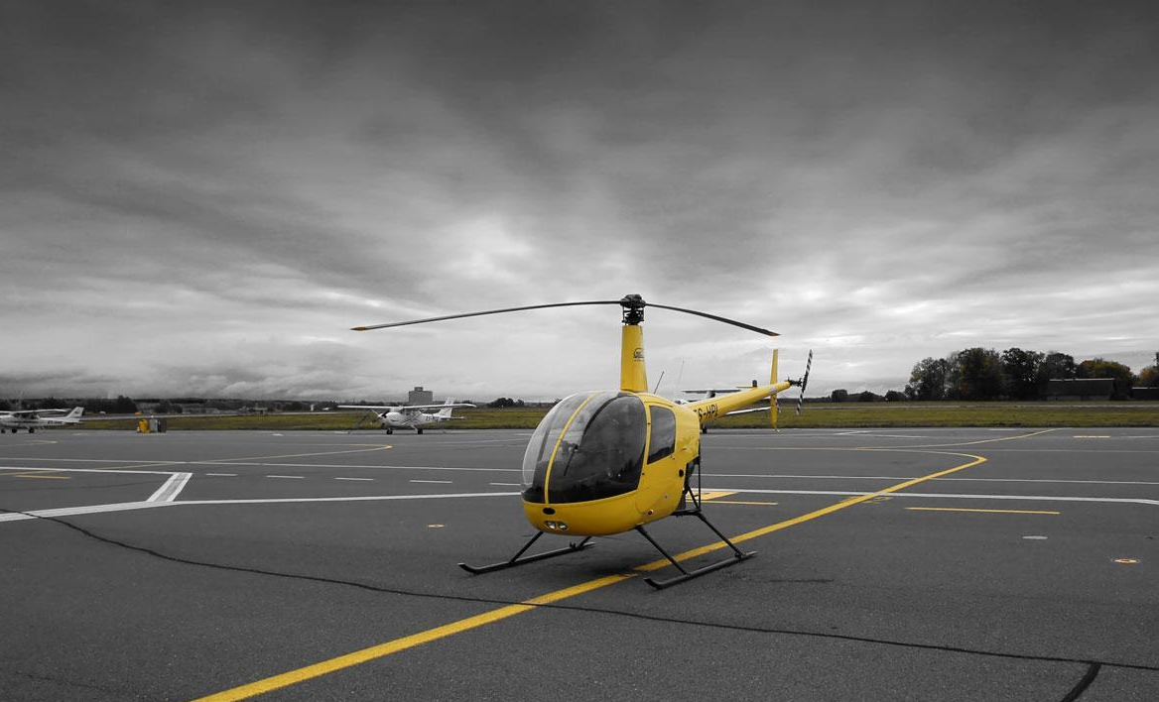
Aircraft Piloting
Certification and Capabilities
EE/ATO/001 - EASA CPL(A,H), ATP(A), MCC
Duration:
2.5 years without Bachelor degree
4 years with Bachelor degree
Who do PIL students become?
Graduates receive Commercial Pilot Licence (with ATP theory).
Practical training (in cooperation with Pakker Avio)
single engine training - Cessna 172, multi-engine - Piper Navajo
helicopter Robinson R22
160 hours on an aircraft, 56 hours on simulator (FNPT II/MCC)
Future employers?
All airlines and operators in Estonia and abroad (EASA license)

Slide 4
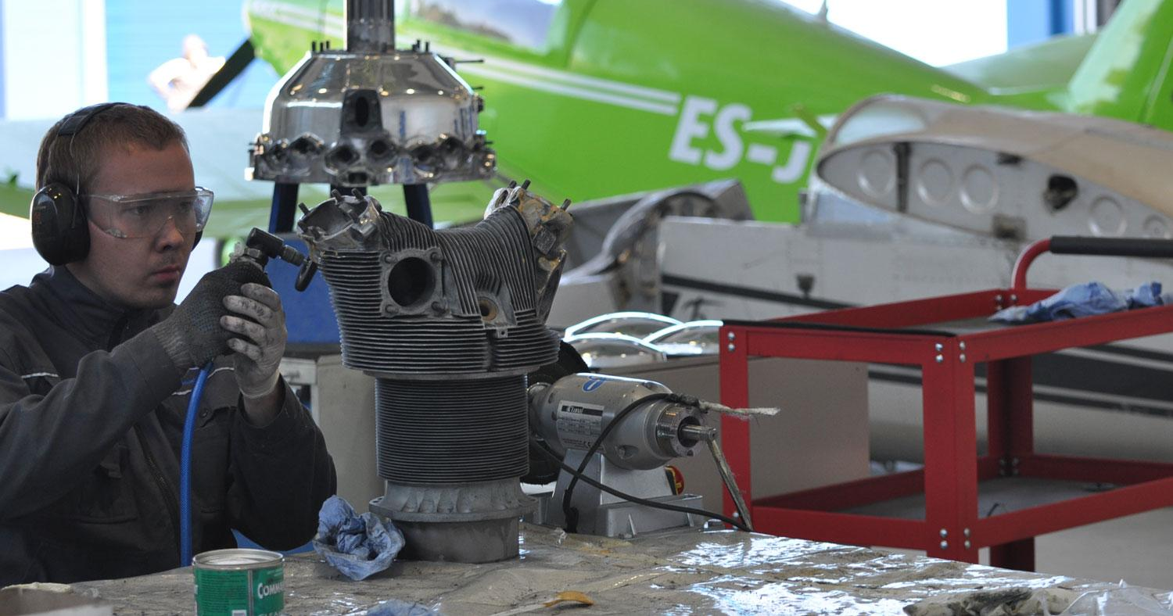
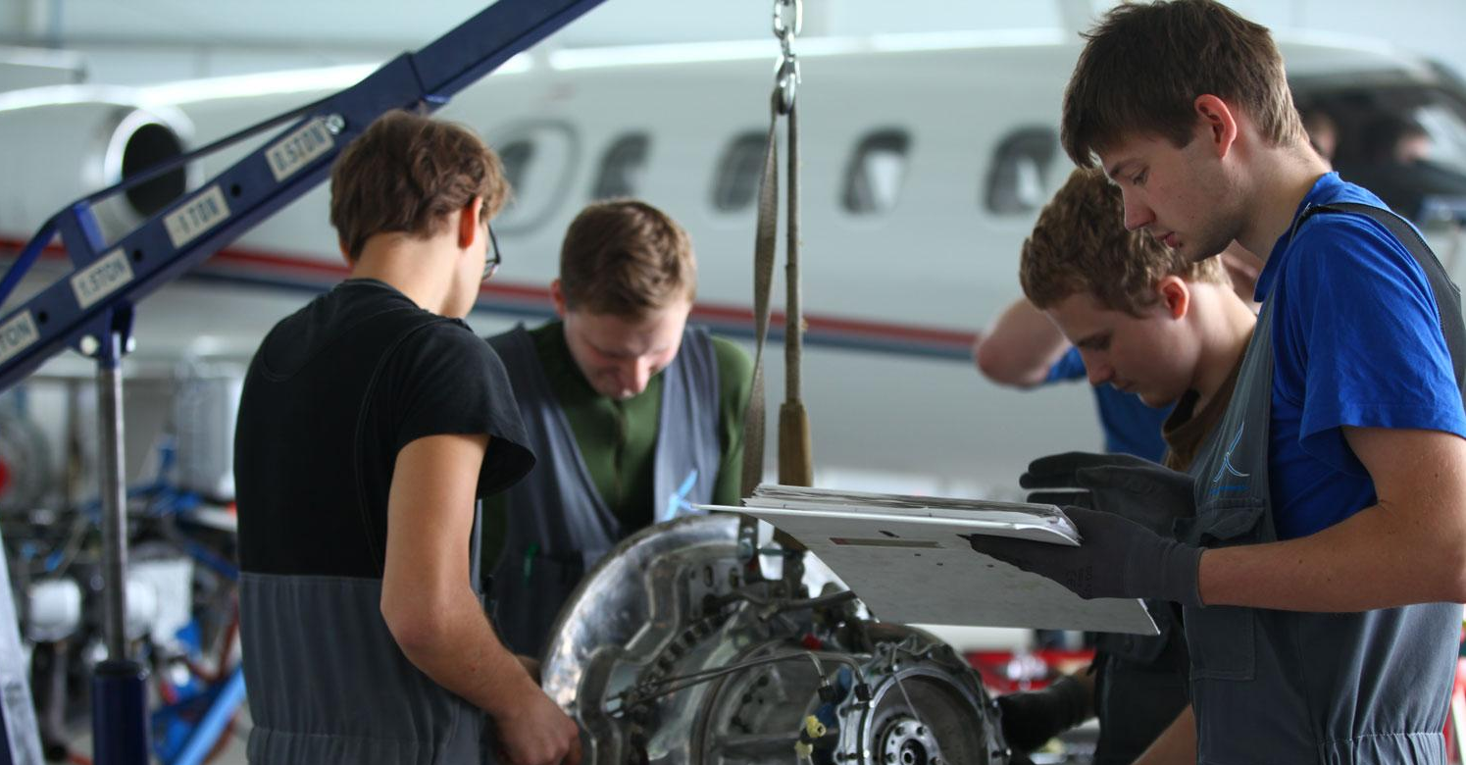
Aviation Maintenance Training
Training certification and capabilities:
EE.147.0001 - EASA Part 147 Category A, B1, B2
Duration:
4 years with Bachelor Degree
2-3 years at Vocational level
Who do TECH students become?
EASA approved aeroplane/helicopter technician (B1.1/B1.3)
EASA Avionics - maintenance and repair of large-scale electrical systems(B2)
Future employers?
All MRO-s in Estonia and Europe, in other countries where EASA license is accepted

Slide 5
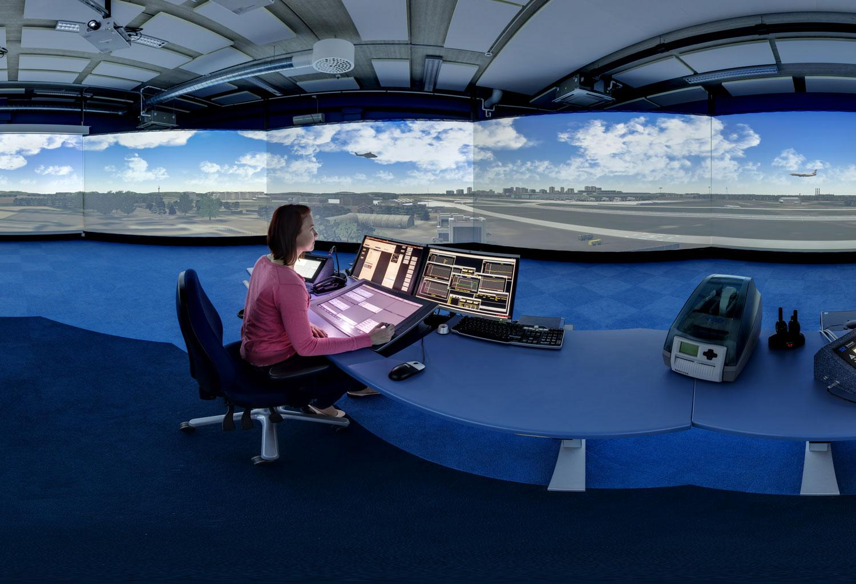
Air Traffic Services
Certification and Capabilities:
4.7-13/001 - EASA Part ATCO ADI, APP, APS, ACS
Duration:
4 years with Bachelor degree
1 year at Vocational level
Who do ATS students become?
TWR controller – air traffic control service for aerodrome traffic
APP controller - controls arriving and departing traffic in the terminal areas up to 3000 m
ACC controller – en-route traffic through entire Estonian airspace
What is studied?
All Part ATCO subjects + technology, economics and enterprise, psychology, meteorology, navigation subjects
Future employers?
ANS providers in Estonia and abroad (English language based).

Slide 6
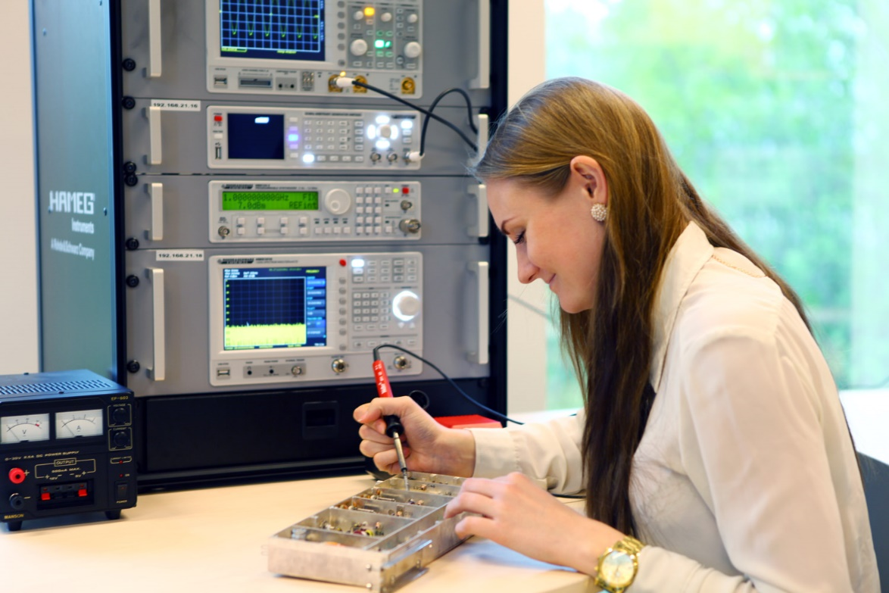
Communication and Navigation Systems
Who do CNS students become?
Technicians and engineers, who know how to configure communication, navigation and surveillance systems
Duration:
4 years with Bachelor degree
What is studied?
ATSEP subjects + electrical engineering and radio technology, electronics, information technology,data processing and many other fields
Future employers?
Estonian Air Force, EANS, Tallinn Airport and ANS providers abroad

Slide 7
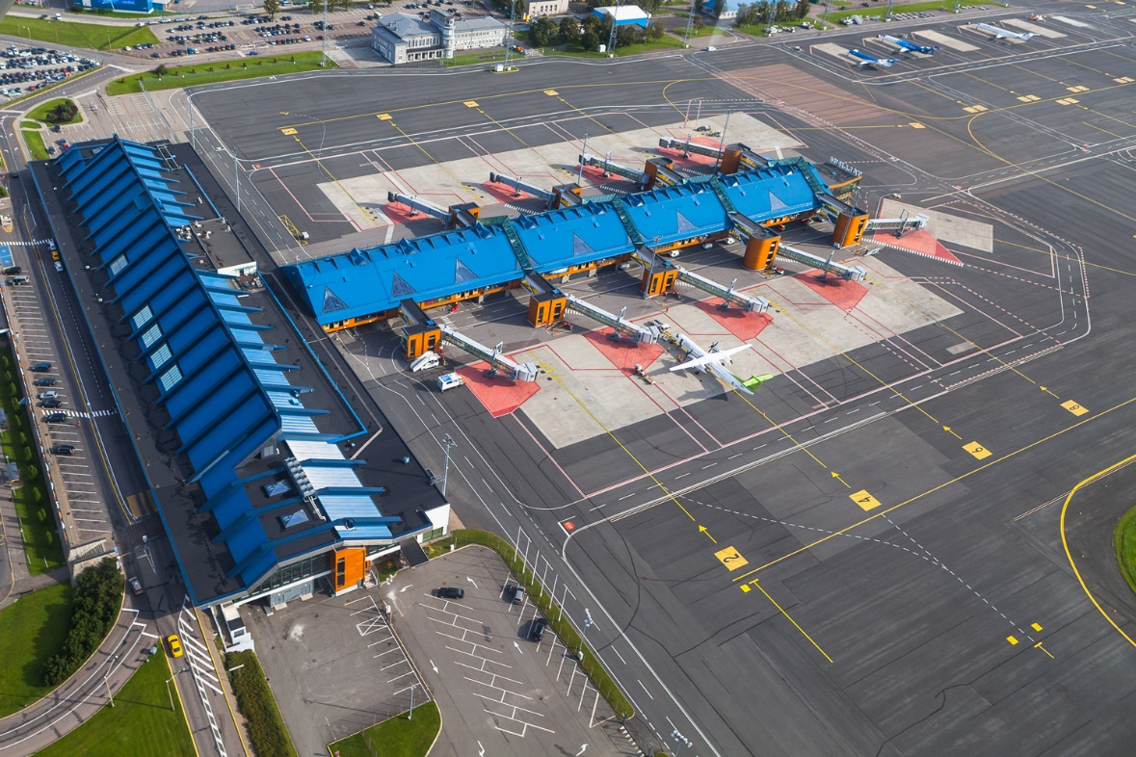
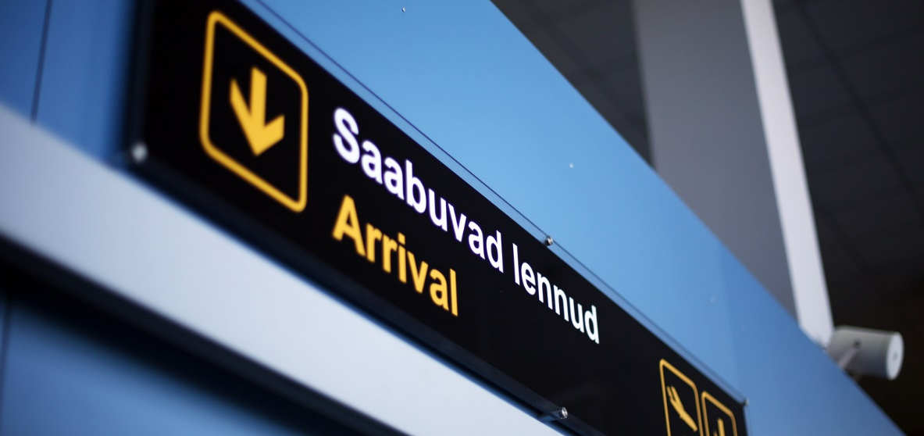
Aviation Management
Who do AM students become?
Aviation management specialist with knowledge of economics and enterprise
Duration:
4 years with Bachelor degree
What is studied?
Aviation company and booking system management, marketing, economics, accountancy, logistics, flight planning and also general subjects in aviation
Future employers?
All airlines, airports, MRO-s and aviation authorities

Slide 8
Cooperation proposal
Aviation Management Program for airport and aviation authority specialists and student candidates (Bachelor level or short courses)
Pilot training for Chinese student candidates (ATPL aeroplane)

