Slide 1
AIR TRAFFIC AND LOGISTICS DEVELOPMENT BETWEEN THE EU RURAL AREAS AND CHINA
Kick Off meeting – Seinajoki
5-6 February 2020

Slide 2
///
BASILICATA REGION
SOME INSIGHTS
564.247 inhabitants
131 municipalities
56 inhabitants / km²
4.307 (average inhabitants per municipality)
Two provinces
POTENZA (369.538 inhabitants)
MATERA (199.303 inhabitants)

Slide 3
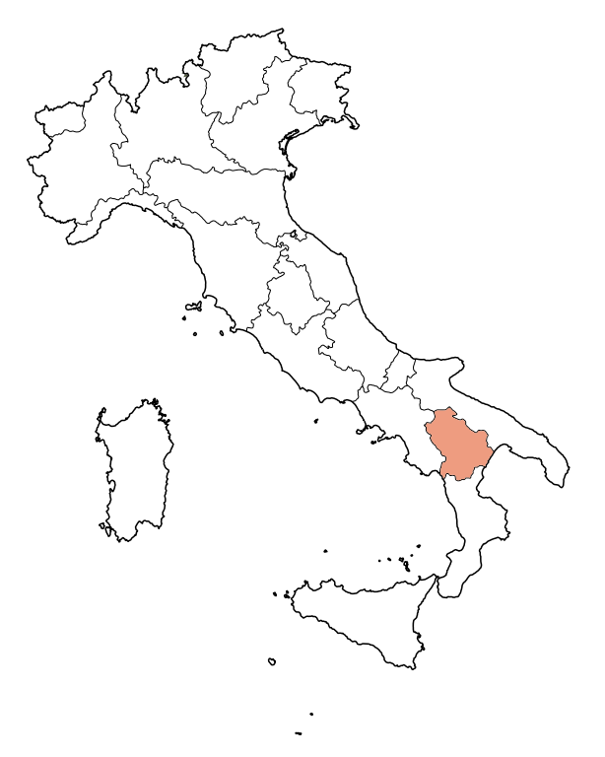
BASILICATA REGION

Slide 4
///
OUR LEADER STRATEGY (1/2)
PROGRAMMING PERIOD 2014/2020
35%
Competitiveness of SMEs and agricultural sector
TOTAL BUDGET
55%
4,8 MILLION
Tourism development
35%
Social and work inclusion, self-employment

Slide 5
///
OUR LEADER STRATEGY (2/2)
MAIN ACTIONS
Competitiveness of SMEs and agricultural sector
Tourism
development
Social and work
Inclusion, self-employment
Micro-Credit
Funding for SMEs
Agricultural supply chains
Funding for hospitality sector
New services for tourists
Tourism de-seasonalization
New green tourism routes
International promotion
Business incubator
Care farming
Refurbishment of public buildings for social purposes

Slide 6
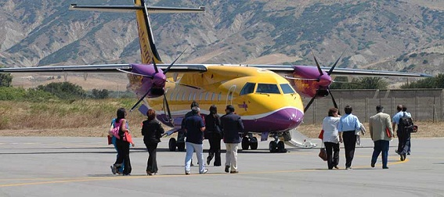
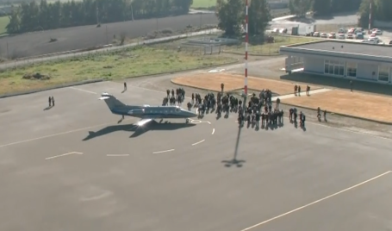
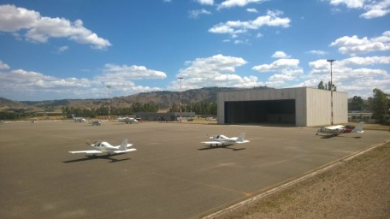
WP2
Feasibility study of the airport network operations and routes, mapping
of investment needs, especially concerning green innovation
STATE OF THE PLAY IN OUR REGION
PISTICCI AIRPORT BASILICATA REGION - ITALY
THE AIRPORT
IS CLOSED
Administrative / legal
dispute with…
Current situation..
Public player, owner of the
infrastructure
Private company, was in charge of the management of the infrastructure
BUT…

Slide 7
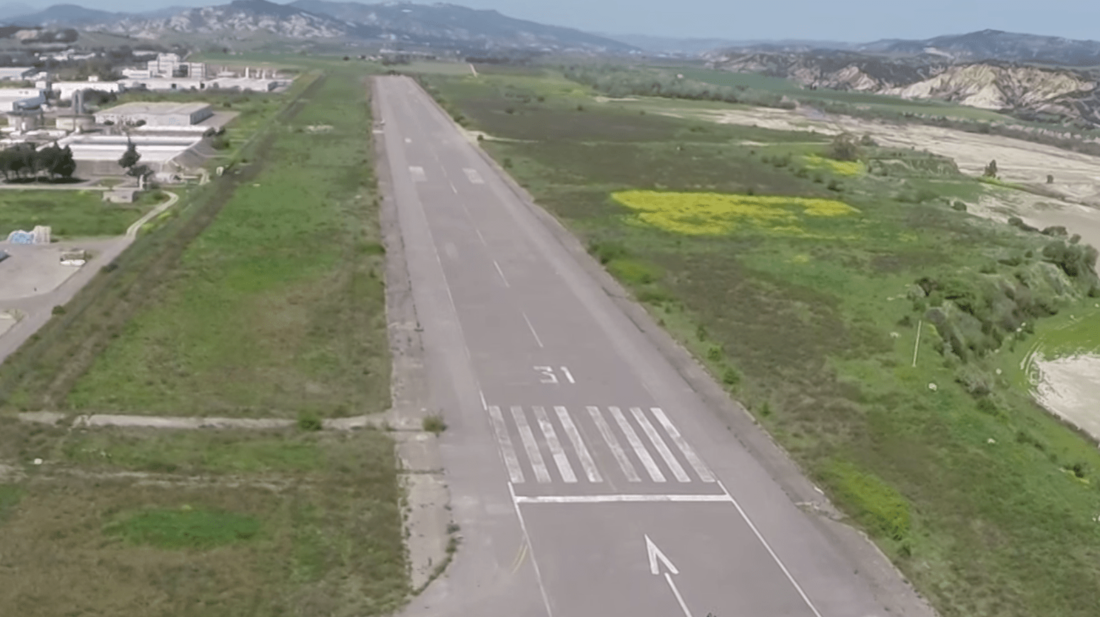
WP2
Feasibility study of the airport network operations and routes, mapping
of investment needs, especially concerning green innovation
STATE OF THE PLAY IN OUR REGION
SOME INTERESTING NEWS
The Region intends to invest on the PISTICCI’s airport
Val Basento (the area in which the airport is located) is now a special tax area

Slide 8
WP2
Feasibility study of the airport network
operations and routes

Slide 9
WP2
Feasibility study of the airport network operations and routes, mapping
of investment needs, especially concerning green innovation
TASK 1 - BUILDING THE TEAM AND DRAFTING THE SPECIFICATION OF FEASIBILITY STUDY
BUILDING THE NETWORK
DESCRIPTION | OBJECTIVE(S) | METHODOLOGY | OUTPUT(S) | TIMING
Mapping and motivating the relevant players in Italy, Estonia, Sweden and Slovenia (Universities, Aviation Academies, Aviation Institutions, Business Support Organizations, National and Local PAs, etc.) | Identification of the players to be involved in the project | Development of a list of reliable and relevant players to be involved | Overall database including information about the identified players | From Nov. 2019
Signing the MoU with the identified players | Local and transnational networking Ensuring advanced know how to the project Ensuring visibility to the project | Development of the MoU template Collecting signatures | MoU with the identified players NOT NEEDED IN ALL THE PROJECT COUNTRIES (??) | From Jan. 2020 to Mar. 2020

Slide 10
WP2
Feasibility study of the airport network operations and routes, mapping
of investment needs, especially concerning green innovation
TASK 1 - BUILDING THE TEAM AND DRAFTING THE SPECIFICATION OF FEASIBILITY STUDY
BUILDING THE ITALIAN NETWORK (to be established)
WP2
FEASIBILITY STUDY
WP3
EU-China aviation training consortium
WP4
Business platforms
WP5
Rural tourism
OTHER
MUNICIPALITIES
LOCAL BUSINESS
SUPPORT
ORGANIZATIONS

Slide 11
WP2
Feasibility study of the airport network operations and routes, mapping
of investment needs, especially concerning green innovation
TASK 1 - BUILDING THE TEAM AND DRAFTING THE SPECIFICATION OF FEASIBILITY STUDY
DRAFTING THE SPECIFICATIONS OF THE FEASIBILITY STUDY
Hiring/involving the aviation experts for carrying out the feasibility study
Market research in progress. Contract(s) expected in March 2020
Making a preliminary mapping of the characteristics of project partners, including ownership and management structures of the airports
Capturing needs, barriers and opportunities
Comparing information
Addressing the development of the feasibility study
By June 2020

Slide 12
WP2
Feasibility study of the airport network operations and routes, mapping
of investment needs, especially concerning green innovation
TASK 2 - CARRYING OUT FEASIBILITY STUDY OF THE AIRPORT NETWORK OPERATIONS AND ROUTES, INPUT FOR STRATEGIC PLANS AND GREEN INNOVATIONS
DEVELOPMENT OF THE FEASIBILITY STUDY
Investigation on potential passengers and airlines (in the airport network)
Research activities and data acquisition
Activity to be implemented at local level by using a common methodology in the project countries

Slide 13
WP2
Feasibility study of the airport network operations and routes, mapping
of investment needs, especially concerning green innovation
TASK 2 - CARRYING OUT FEASIBILITY STUDY OF THE AIRPORT NETWORK OPERATIONS AND ROUTES, INPUT FOR STRATEGIC PLANS AND GREEN INNOVATIONS
DEVELOPMENT OF THE FEASIBILITY STUDY
Input collection for long-term strategic plans and the development visions of partner airports and regional / national authorities
Meetings and workshops with partner airports and regional / national authorities
Connection with WP3 (testing robotics and automisation)
Connection with WP5 (rural tourism)
By June 2020
Activity to be implemented at local level by using a common methodology in the project countries

Slide 14
WP2
Feasibility study of the airport network operations and routes, mapping
of investment needs, especially concerning green innovation
TASK 2 - CARRYING OUT FEASIBILITY STUDY OF THE AIRPORT NETWORK OPERATIONS AND ROUTES, INPUT FOR STRATEGIC PLANS AND GREEN INNOVATIONS
DEVELOPMENT OF THE FEASIBILITY STUDY
Potential of cargo in a radius of app. 100-150 km around the airports
Supporting the cargo development
Surveys to concerned enterprises with the support of the business support organizations
Connection with WP4 (business platforms)
Activity to be implemented at local level by using a common methodology in the project countries

Slide 15
WP2
Feasibility study of the airport network operations and routes, mapping
of investment needs, especially concerning green innovation
TASK 2 - CARRYING OUT FEASIBILITY STUDY OF THE AIRPORT NETWORK OPERATIONS AND ROUTES, INPUT FOR STRATEGIC PLANS AND GREEN INNOVATIONS
DEVELOPMENT OF THE FEASIBILITY STUDY
Investigation on the airport network operation, routes and investments
Meetings and workshops with aviation players and relevant authorities in the project countries
Connection with WP3 (testing robotics and automisation)
Connection with WP5 (rural tourism)
Transnational activity
Chinese partners’ support is crucial

Slide 16
WP2
Feasibility study of the airport network operations and routes, mapping
of investment needs, especially concerning green innovation
TASK 2 - CARRYING OUT FEASIBILITY STUDY OF THE AIRPORT NETWORK OPERATIONS AND ROUTES, INPUT FOR STRATEGIC PLANS AND GREEN INNOVATIONS
TIME SCHEDULE
TASK | SUB-TASK | 2020 |  |  |  |  |  |  |  |  |  |  |  | 2021
 |  | Jan | Feb | Mar | Apr | May | Jun | Jul | Aug | Sep | Oct | Nov | Dec | Jan | Feb | Mar | Apr | May | Jun | Jul | Aug | Sep | Oct | Nov | Dec
BUILDING THE TEAM AND DRAFTING THE SPECIFICATION OF FEASIBILITY STUDY | Mapping and motivating the relevant players in Italy, Estonia, Sweden and Slovenia | ● | ● | ●
 | Signing the MoU with the identified players | ● | ● | ●
DRAFTING THE SPECIFICATIONS OF THE FEASIBILITY STUDY | Hiring the local aviation experts for carrying out the feasibility study | ● | ● | ●
 | Making a preliminary mapping of the characteristics of project partners | ● | ● | ● | ● | ● | ●
DEVELOPMENT OF THE FEASIBILITY STUDY | Investigation on potential passengers and airlines (in EU and outside) |  |  |  |  |  |  | ● | ● | ● | ● | ● | ●
 | Input collection for long-term strategic plans and the development visions of partner airports and regional / national authorities |  |  |  |  |  |  | ● | ● | ● | ● | ● | ● | ● | ● | ● | ● | ● | ● | ● | ● | ● | ● | ● | ●
 | Investigating the potential of cargo in a radius of app. 100-150 km around the airports |  |  |  |  |  |  | ● | ● | ● | ● | ● | ● | ● | ● | ● | ● | ● | ● | ● | ● | ● | ● | ● | ●
 | Investigation on the airport network operation, routes and investments |  |  |  |  |  |  | ● | ● | ● | ● | ● | ● | ● | ● | ● | ● | ● | ● | ● | ● | ● | ● | ● | ●

Slide 17
CONTACTS
LAG La Cittadella del Sapere
ADDRESS C.da Calda, Latronico (Pz) - Italy
Nicola Vita – Project Manager
vita@lacittadelladelsapere.it

