Slide 1
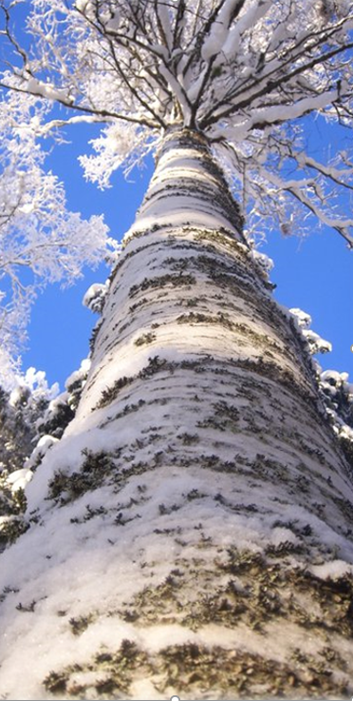
Sedu in numbers
Education in 7 different units
full time education for 5000 students
work for 600 staff members
continuing education or further training for 10 000 students
preparatory vocational education and training for growing numbers of young people

Slide 2
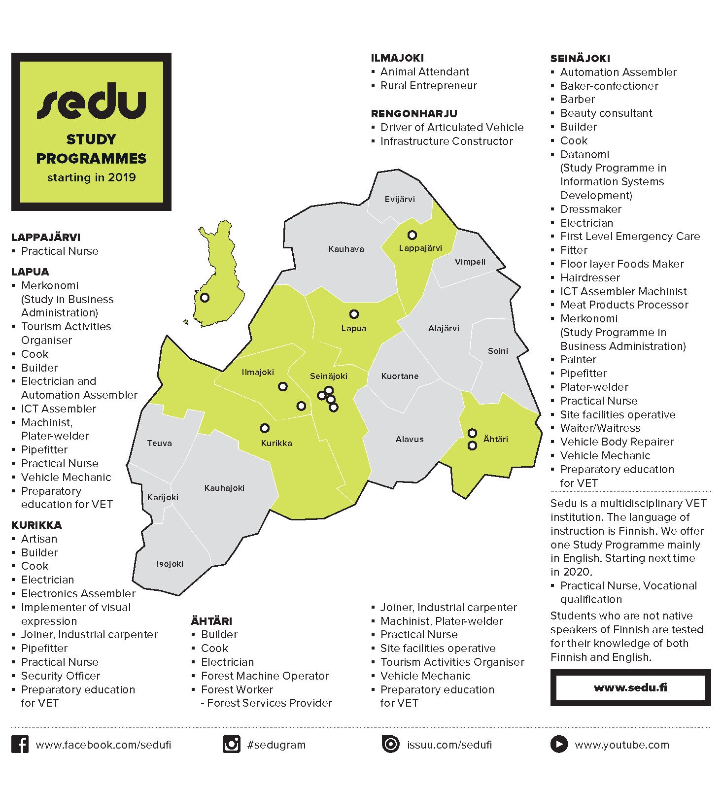
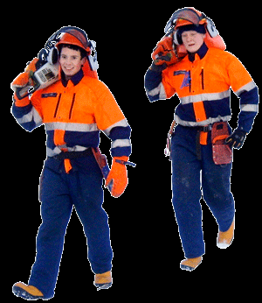
41
Vocational qualifications
66
further vocational qualifications
37
specialist vocational qualifications

Slide 3
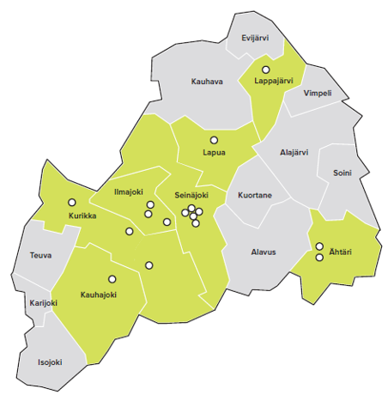
Sedu Ilmajoki Campus
Education and Training in three locations
Agriculture training in Ilmajoentie
Logistics and earthmoving operator, forest machine (harvester/forwarder) training in Rengonharju (Airport area)
Training in Vaasa in logistics and earthmoving (labour policy education)
Education Manager Mr. Hannu Muhonen
Sedu / TVu 1-2019

Slide 4
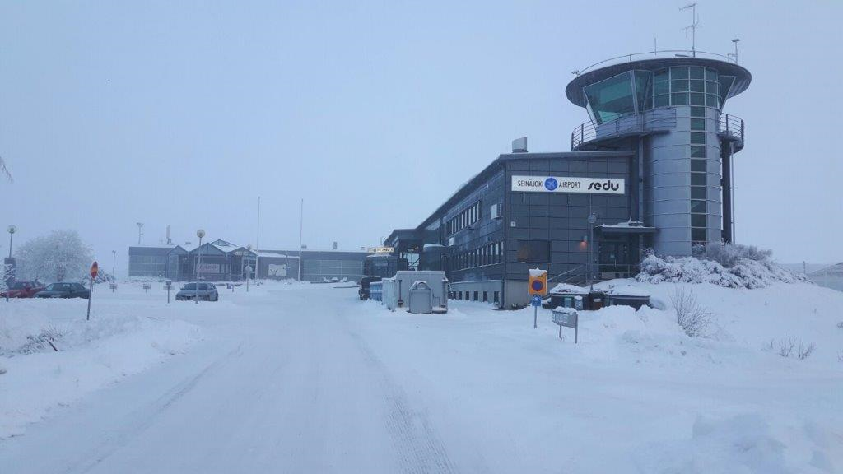
Rengonharju
Studies offered in the Rengonharju unit
Vocational Qualification in Logistics, Articulated Vehicle Driver, young and adults
Vocational Qualification in Logistics, Bus Driver, adults
Vocational Qualification in Logistics, Truck Driver, adults

Slide 5
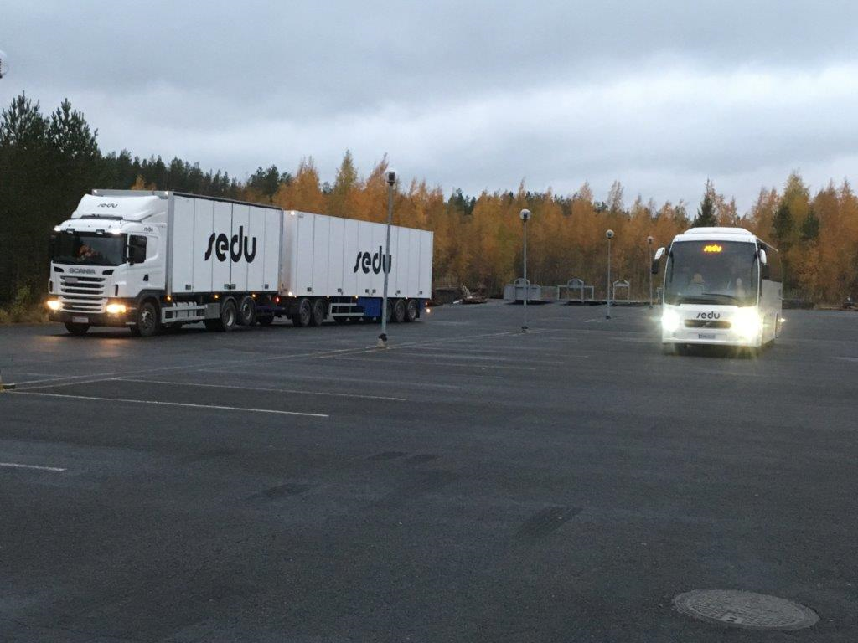
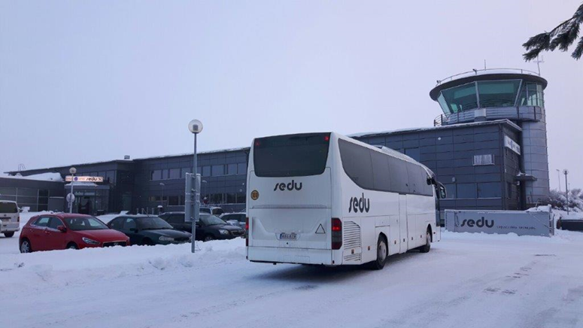
Rengonharju
Further vocational qualification in Logistics, competence area in transportation of goods
Further vocational qualification in Logistics, competence area in transportation of timber
Further vocational qualification in Logistics, competence area in transportation of people

Slide 6
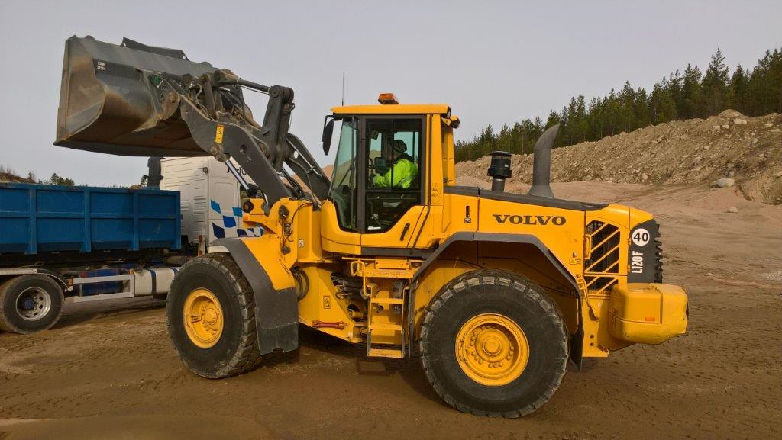
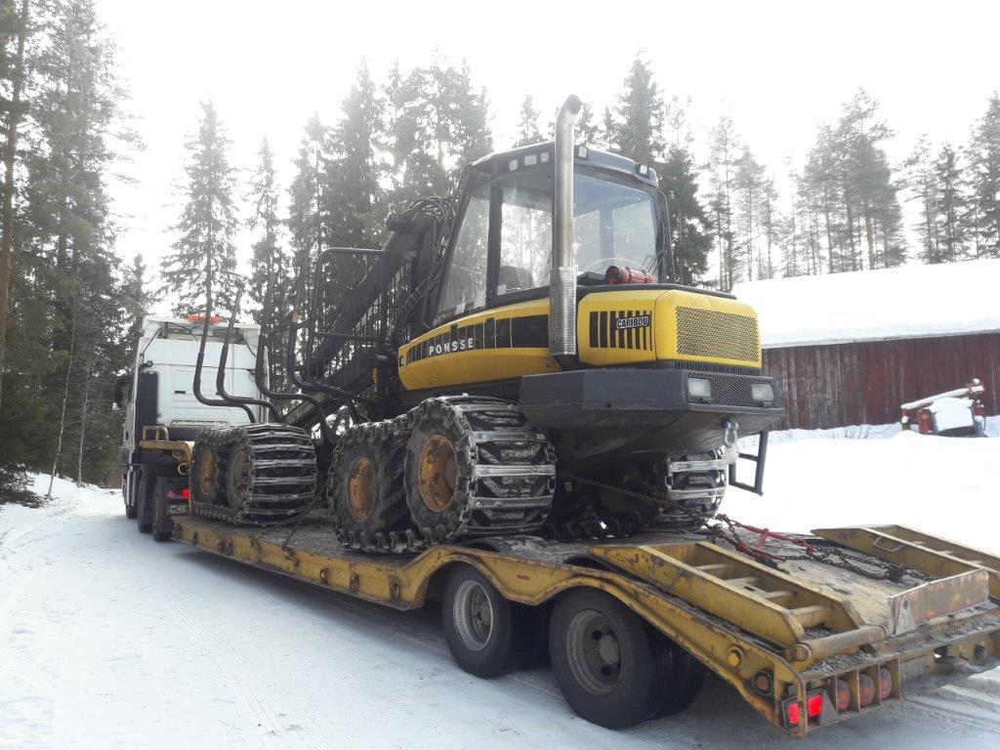
Rengonharju
Vocational Qualification in Construction, competence area in earthmover operation, Earthmover Operator, young and adults
Further Vocational Qualification in Construction, competence area in earthmover operation, Earthmover Operator
Specialist Vocational Qualification in Construction, competence area in earthmover operation, Earthmover Operator
Further Vocational Qualification in Forestry, competence area in Forest Machine Operation

Slide 7
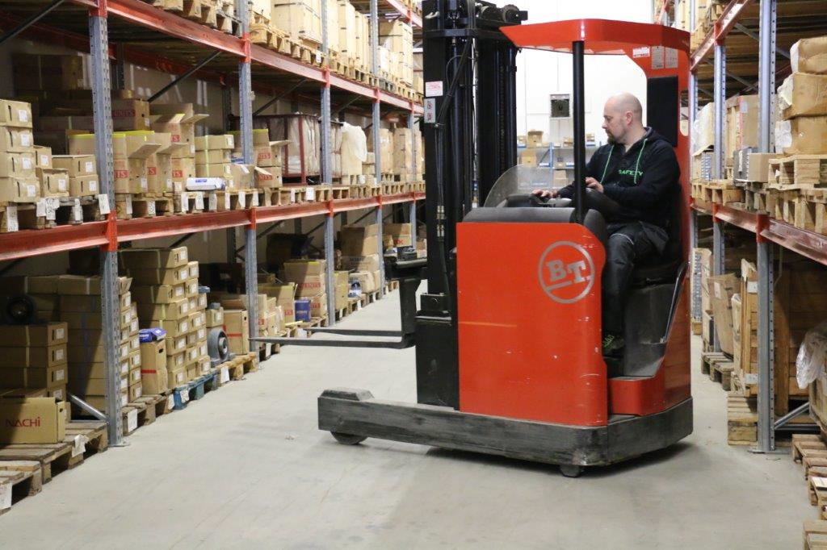
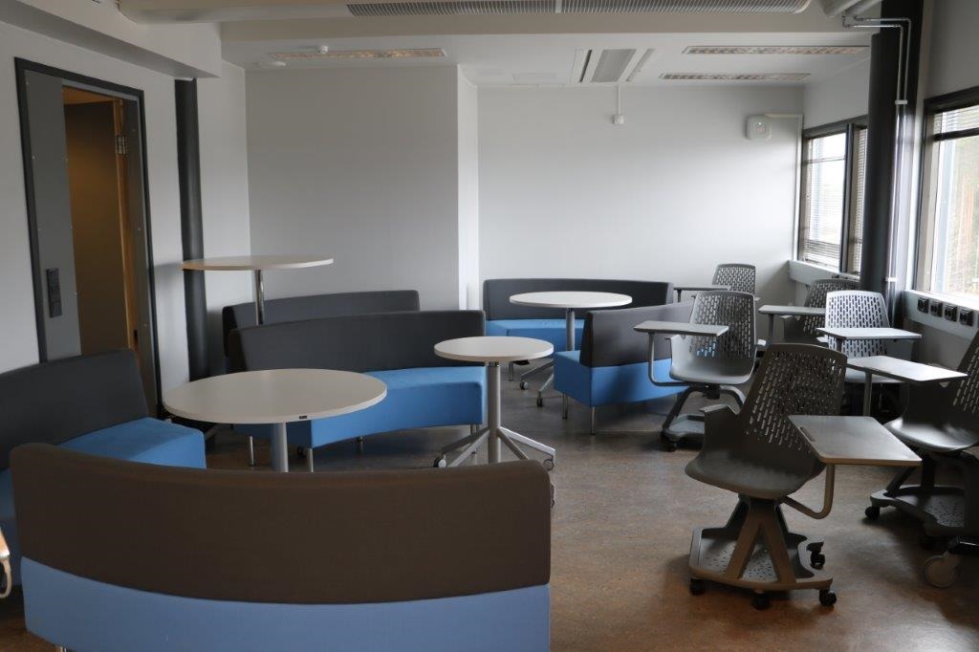
Rengonharju
Vocational Qualification in Logistics, competence area in storage services, Warehouse Operative (adult education)
Further Vocational Qualification in Construction in service logistics
Specialist Vocational Qualification in service logistics
Rengonharju has several types of classrooms and meeting rooms with modern equipment and tools.

Slide 8
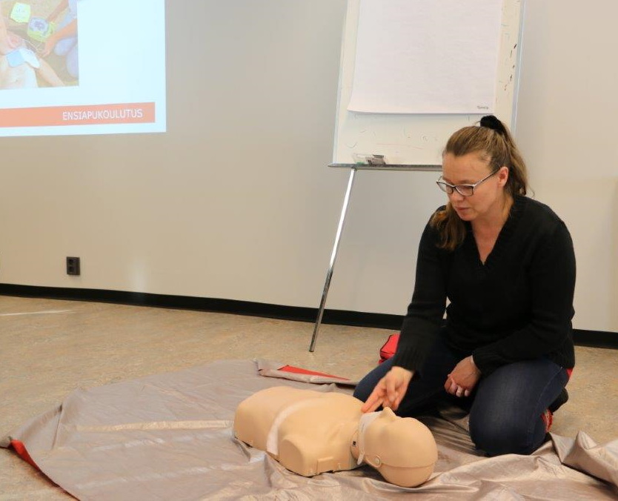
Rengonharju
Professional Qualifications, e.g.
Basic First Aid (1&2)
Emergency First Aid
ADR (European Agreement concerning the International Carriage of Dangerous Goods by Road)
Road Safety 1
Work Safety
Plastic pipe welding
Charger’s certificate (explosives)

Slide 9
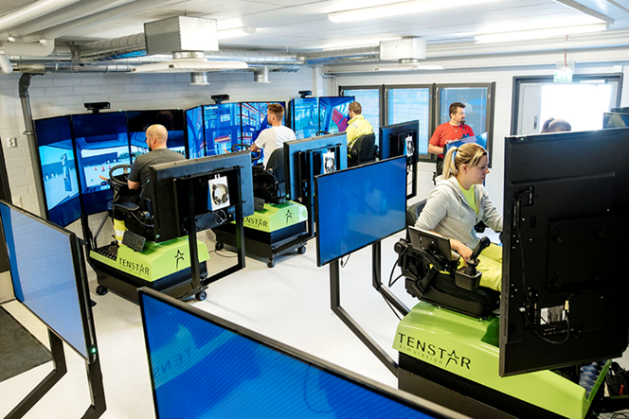
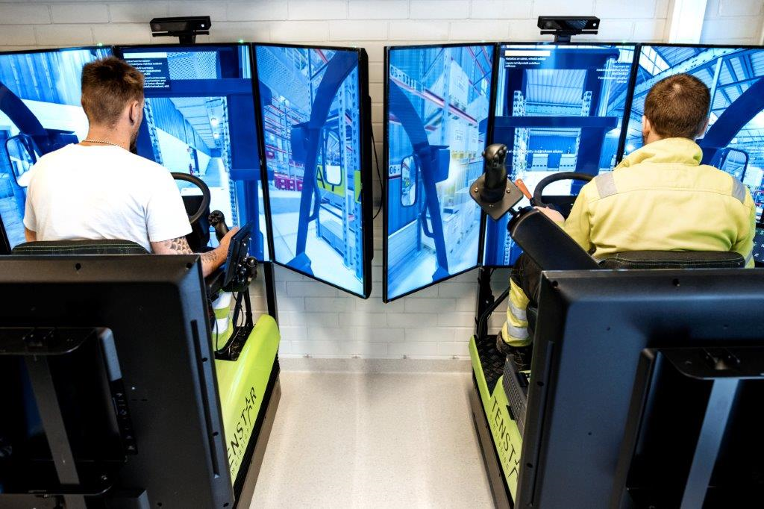
Rengonharju
12 driving simulators are in active use in vocational education and training as well as in in-service training for companies.
Simulation training in the fields of logistics, earthworks, forestry and agriculture. The simulators include more than 10 different work machines or vehicles and over 100 exercises.
The simulation environment is as close to the real life as possible. Sedu has state of the art training facilities which are equipped with the latest simulation technology.

Slide 10
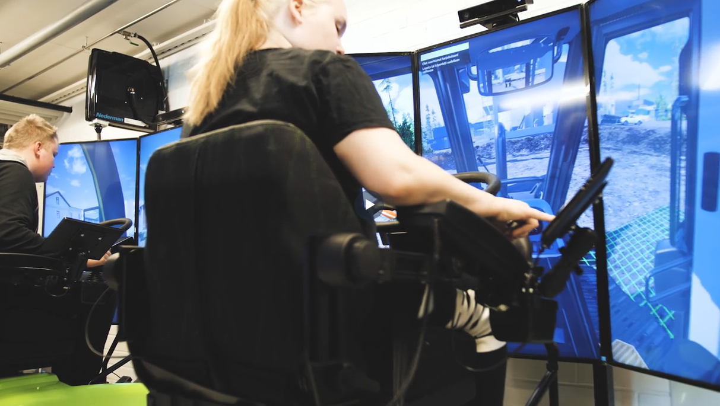
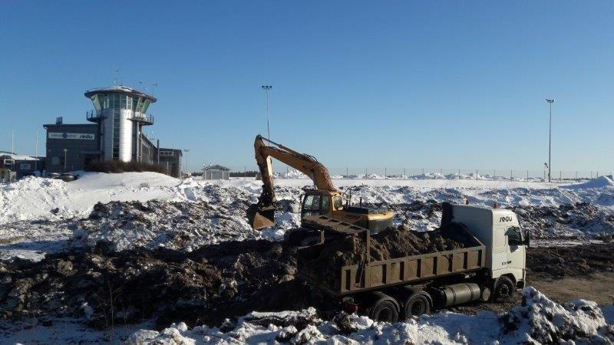
Rengonharju
Vocational education and training in Rengonharju started in 2018.
Improvements in the campus since 2018: practice area for the machinery, loading dock and a parking area for the equipment
+300 students
50 staff members, out of which 40 are teachers

Slide 11
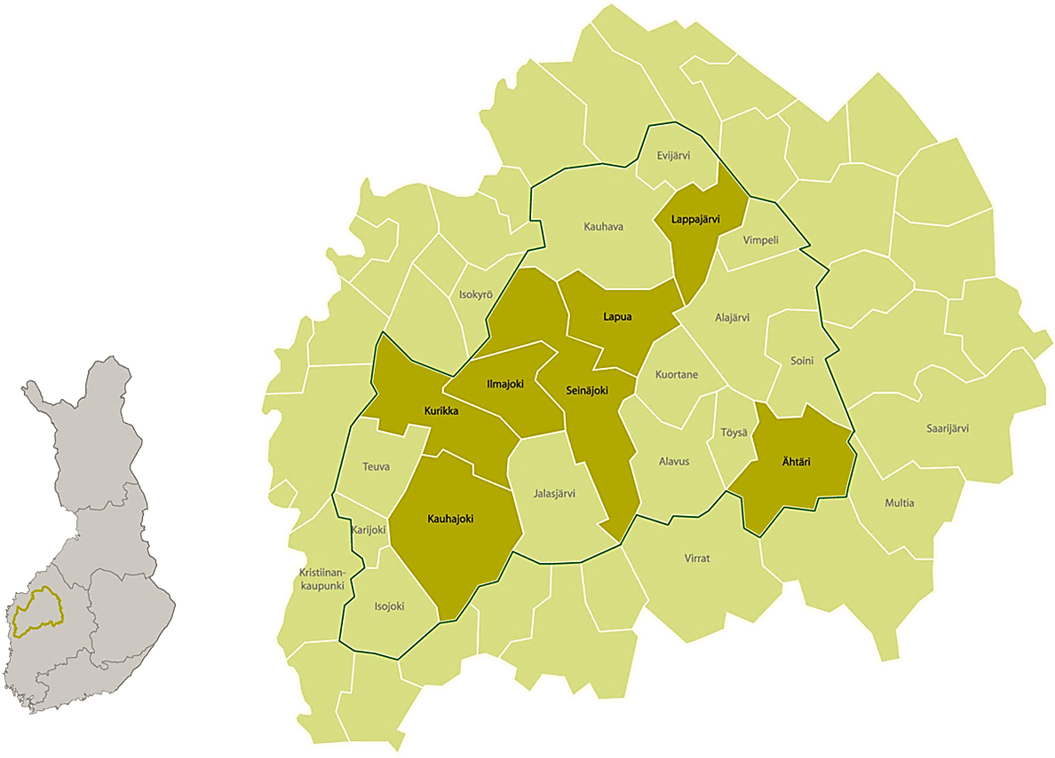
Contact us
Seinäjoki Joint Municipal Authority for Education Sedu
Koulukatu 41
FIN - 60101 Seinäjoki
https://www.sedu.fi/en
Sedu Ilmajoki, Rengonharju
Hannu Muhonen Tuire Karvala Education Manager International coordinator
hannu.muhonen@sedu.fi tuire.karvala@sedu.fi

