Slide 1
SLOVENIA LAG PRLEKIJA
GORAN ŠOSTER, Manager of LAG PRLEKIJA / DEVELOPMENT AGENCY

Slide 2
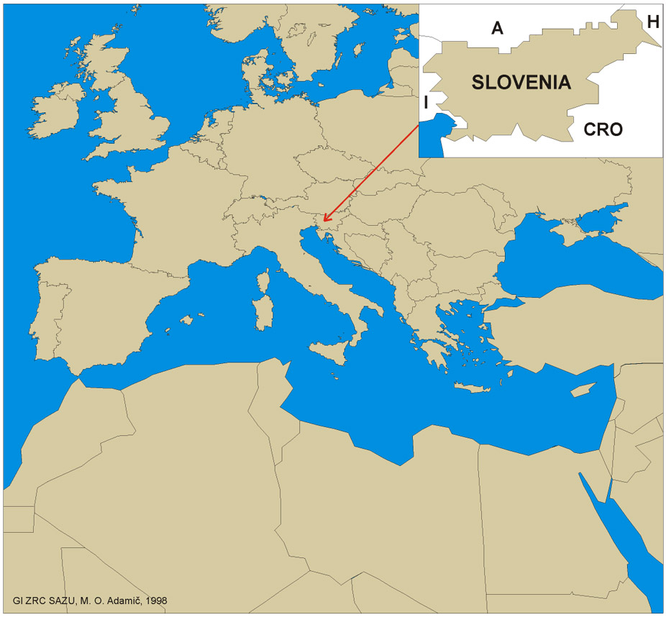

Slide 3
SLOVENIA basic data
Inhabitants: 2 milion
Language: Slovenian
State: since 1991, member of European Union since 2004
Currency: Euro
Capital: Ljubljana (350.000 inhabitants)
Climate:
Mediteranian in the West;
Alpine in the North
Continental in the East

Slide 4
SLOVENIA Socio-economic data
Gross earnings: 1.730 €
Unemployment: 4,4%
GDP per capita: 26.586 USD
GDP growth: 4,1%
Inflation: 1,2%
Employment by sectors:
Agriculture: 1,8%
Industry: 28,8%
Services: 56,4%

Slide 5
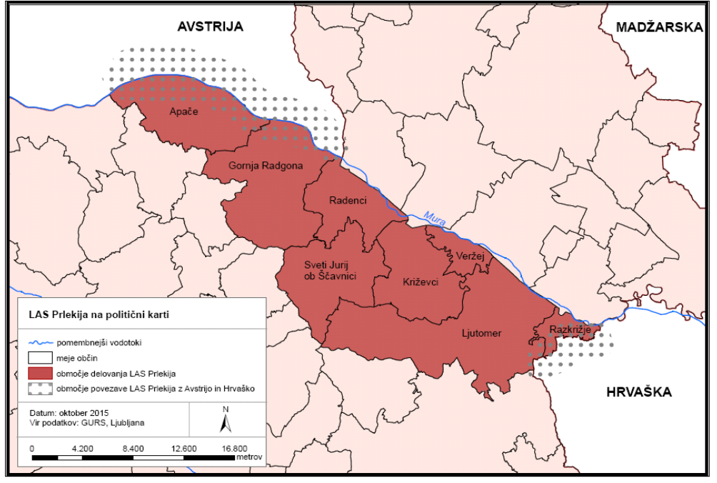
Območje LAS Prlekija 2014-2020
8 občin
38.113 prebivalcev
169 naselij
površina 388,7 km²

Slide 6
PRESENTATION CONTENTS
State of art of the project in Slovenia
Airport Maribor – actual data
Work package TOURISM

Slide 7
State of art of the project in Slovenia
TNC project was aproved at the LAG level
The source of financing of the project will be ERDF
The ERDF/CLLD rules require the change of the Lcal Development Strategy
Changes of the LDS were submitted together with many other items in November 2019
Unofficial opinion of administrators about the time of aproval we can expect the confirmation of the project (changed LDS) in March/April 2020
Until the start of the project LAG prlekija can act only in the simple mode, without project activities, covering the basic costs from LAG animation

Slide 8
Airport Maribor

Slide 9
Airport Maribor current situation
Chinese partner SHS Aviation withdraw from the contract of management of the airport for several reasons. Probably the main reason was too slow progress in the changing of the spatial plan to enable the prolongation of the departure/arrival track
Government gave the management of the airport in the hand of the state agency for traffic, which took the most of the staff from the Chinese partner
Chinese partner is still present at the facilities and owns some land around the airport (parking, road), if the situation would change, they would apply for the new contract
Airport is operating only formaly (EU aid), almost no air traffic, some training services

Slide 10
http://www.maribor-airport.si/Interaktivnoletali%C5%A1%C4%8De/Fotogalerija.aspx
PHOTOGALERY

Slide 11
Work package TOURISM
Task 1:
Development of joint rural tourism platform to introduce local destinations and products
Activities 1.1.
Mapping the assets of partners and partner’s areas (tourism aspect)
Preparing the guidelines for partners and the questionnaire with the aim to gather the data about the assets, opportunities and challenges in tourism from the regions involved. Regions are considered as the areas in the circle 50-100 km around the secondary airports. Guidelines and questionnaires prepared by the lead partner of WP 5. March-April 2020.
Partners gathering the data about tourist assets, capacities and trends in their regions. Filling the questionnaires with assistance from the tourist boards/agencies in particular regions. May-June 2020.
Gathering the data and drafting the report, analysis of the potentials for development of rural tourism in the partnership around the TNC project. July-August 2020

Slide 12
Work package TOURISM
Task 1:
Development of joint rural tourism platform to introduce local destinations and products
Activities 1.2.
Design of the platform of the European rural tourism network (e.g. www.visitruraleurope.com)
Lead partner of WP 5 launches the call for provider of the research/study about the existing rural tourism platforms, networks and businesses in Europe (outsourcing). May 2020.
Carrying out the research/study by the selected company (outsourced). June-September 2020.
Coordinations of discussion about the findings form the research/study (lead partner of the WP 5), all partners involved and responding. Decision about the appropriate model or platform, applicable for the partnership in TNC project. October-November 2020.

Slide 13
Work package TOURISM
Task 1:
Development of joint rural tourism platform to introduce local destinations and products
Activities 1.3.
Design of the concept for branding of the European rural tourism network
Designing the draft concept for branding. Lead partner of the WP 5 drafting the concept and partners commenting and contributing to the final outcome. October-December 2020.
Conceptualizing the visual identity/corporate design (outsourced). November-December 2020

Slide 14
Work package TOURISM
Task 1:
Development of joint rural tourism platform to introduce local destinations and products
Activities
1.4. Monitoring and evaluation of the progress of the WP 5 (horizontal activities linked to other WPs).
1.5. Running negotiations with Chinese partners and building linkages (horizontal activities linked to other WPs).
1.6. Exploring the available funds and financing possibilities in Europe and China for further development of the project (horizontal activities linked to other WPs).

Slide 15
Work package TOURISM
Task 2:
Creating the pilot products and promotion tools
Activities 2.1.
Design of the pilot products of the network
Based on the findings from the mapping of the assets (1.1.) designing of the few pilot tourist products, synchronized between involved partner’s regions (regional ITP). June 2020.
Based on the findings from the research/study (1.2.) designing of the few pilot tourist products, synchronized between involved partner’s regions (transnational ITP). October 2020.
Selection of the tourist agencies, performing the trading of the ITPs and booking strategy. November 2020.
Agreement between the TNC project partners and tourist agencies. December 2020.

Slide 16
Work package TOURISM
Task 2:
Creating the pilot products and promotion tools
Activities 2.2.
Promotion tools (Website, FB profile, Instagram profile, Draft catalogue)
Design of the contents for the promotion tools (all partners, coordination by the lead partner of the WP 5). January 2021.
Development and implementation of the promotion tools (outsourced). January 2020.

Slide 17
Work package TOURISM
Task 3:
Finding possibilities for flight and train connections inside the rural tourism network
Activities 3.1.
Testing of the platform and of the pilot products (in tourism), launch of the first routes
Internal study visit of each destination to check the feasibility of ITPs. February-May 2021.
Promotion and trading of ITPs. March-December 2021.

Slide 18
Work package TOURISM
Task 3:
Creating the pilot products and promotion tools
Activities 3.2.
Testing of the platform and of the pilot products (in tourism), launch of the first routes
Internal study visit of each destination to check the feasibility of ITPs. January-June 2021.
Promotion and trading of ITPs. February-December 2021.

Slide 19
Work package TOURISM
Costs and the human resources of the WP leader
Estimated expenses:
Management costs of the WP, expert fees, travel costs, hosting costs of meetings in Europe and in China, outsourced services.
Estimated working days for the management of the WP:
2,5 working days per month throughout the half project period 10 months, altogether 30 working days.
Estimated working days for the implementation of the WP (valid for the lead partner LAG Prlekija only):
10 working days per month throughout the project period 20 months, altogether 200 working days.

Slide 20
THANKS FOR YOUR ATTENTION !
GORAN ŠOSTER
goran@prlekija.com
SLOVENIA
Development Agency – LAG PRLEKIJA
www.prlekija.com and www.las-prlekija.com

