Slide 1
Tartu Airport

Slide 2
History
Airport was established 15. May 1946 as a medical airport
Asphalt runway was built in 1975
Passenger terminal was opened in 14.August 1981
Autumn 2008 the runway was extended to 1 799 meters
10.December 2009 was opened a renovated passenger terminal

Slide 3
Technical specifications
Runway – 1 799 meters long and 31 meters wide
Approach types – 08 visual approach, non-precision approach
26 visual approach, non-precision approach I Cat precise approach – ILS
Airport reference code – 3C
Airport rescue category- 5

Slide 4
Types of flight
Study
Scheduled
Medical
Military
Private

Slide 5
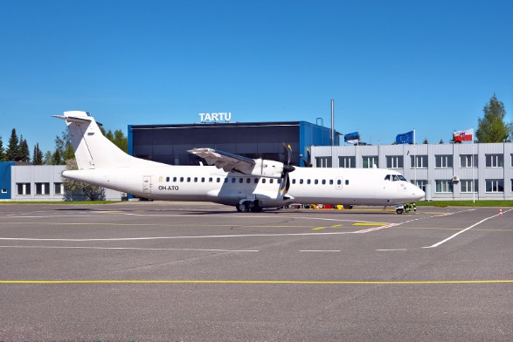
Finnair regular flight – ATR 72

Slide 6
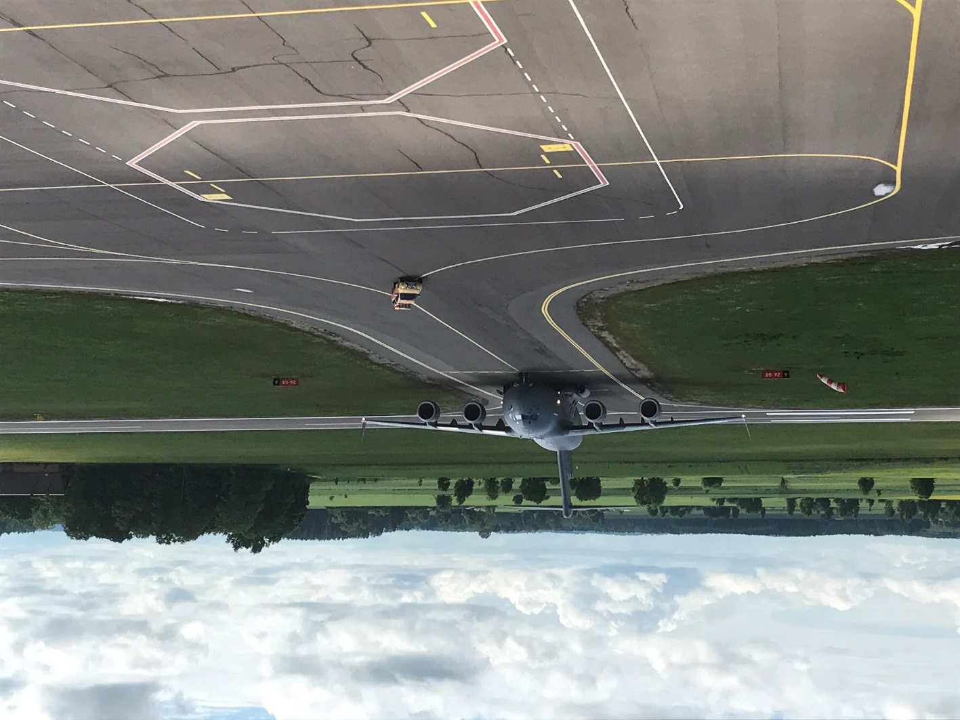
The biggest guest– Boeing C-17 Globemaster III

Slide 7
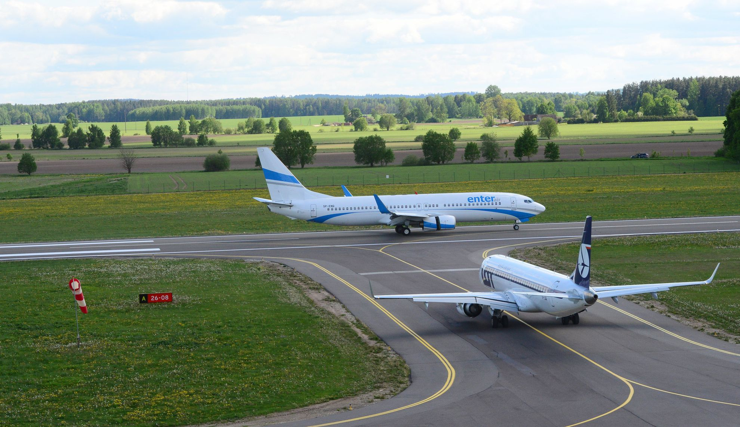
Some unusual day – EMB195 and Boeing 737-800

Slide 8
Number of passengers, 2014-2018

Slide 9
Future prospects
More destinations
Popular final destinations
Stockholm Arlanda
London Heathrow
Brussels Airport
Paris Charles de Gaulle

Slide 10
Thank you!

